Slide 1
Agentic AI Frameworks
Agentic AI Exchange
Renato Rocha Souza
11.11.2025

Slide 2
Presentation Agenda
Executive Summary
From LLMs to Agents
Agentic Frameworks
Q&A

Slide 3
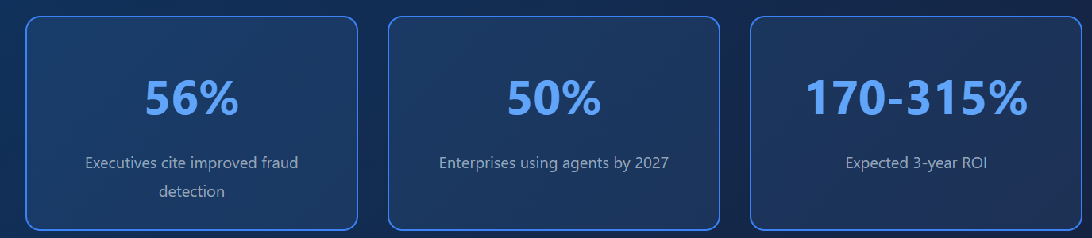
Executive Summary
Agentic AI is the next frontier: Autonomous systems that reason, plan, and execute complex tasks with minimal human intervention
Deloitte predicts that by 2025, 25% of enterprises leveraging AI will deploy intelligent agents, with adoption expected to rise to 50% by 2027
Agentic AI is set to disrupt retail and SME banking first, particularly in markets where open banking has taken root
Banks are moving past generic automation goals to focus on applying AI to specific, high-friction workflows—especially in lending, onboarding, and document-heavy processes
Early movers in agentic AI implementation will gain significant competitive advantage in customer experience, operational efficiency, and risk management

Slide 4
From LLMs to Agents

Slide 5
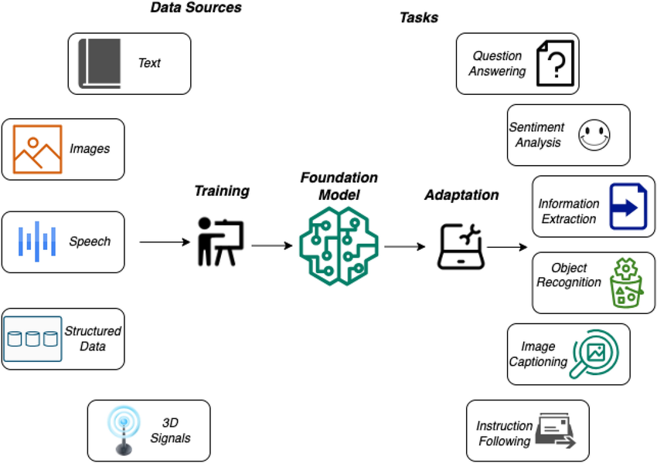
LLM: Learned Probability Distribution of Words

Slide 6
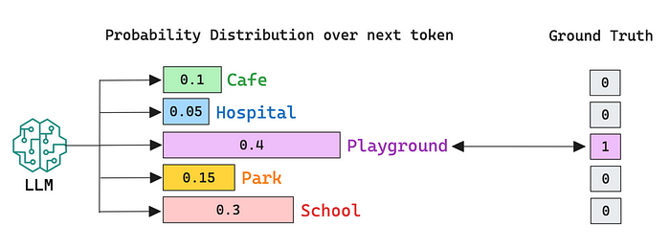
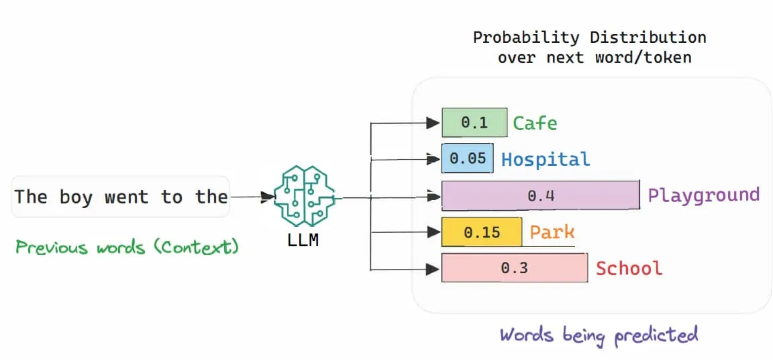
LLM: Learned Probability Distribution of Words

Slide 7
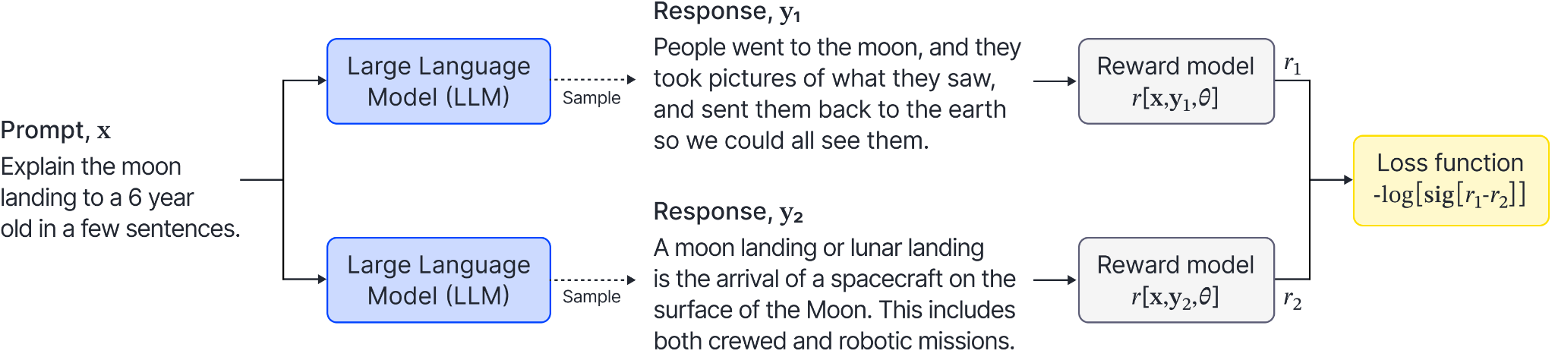
Fine Tuning Models

Slide 8
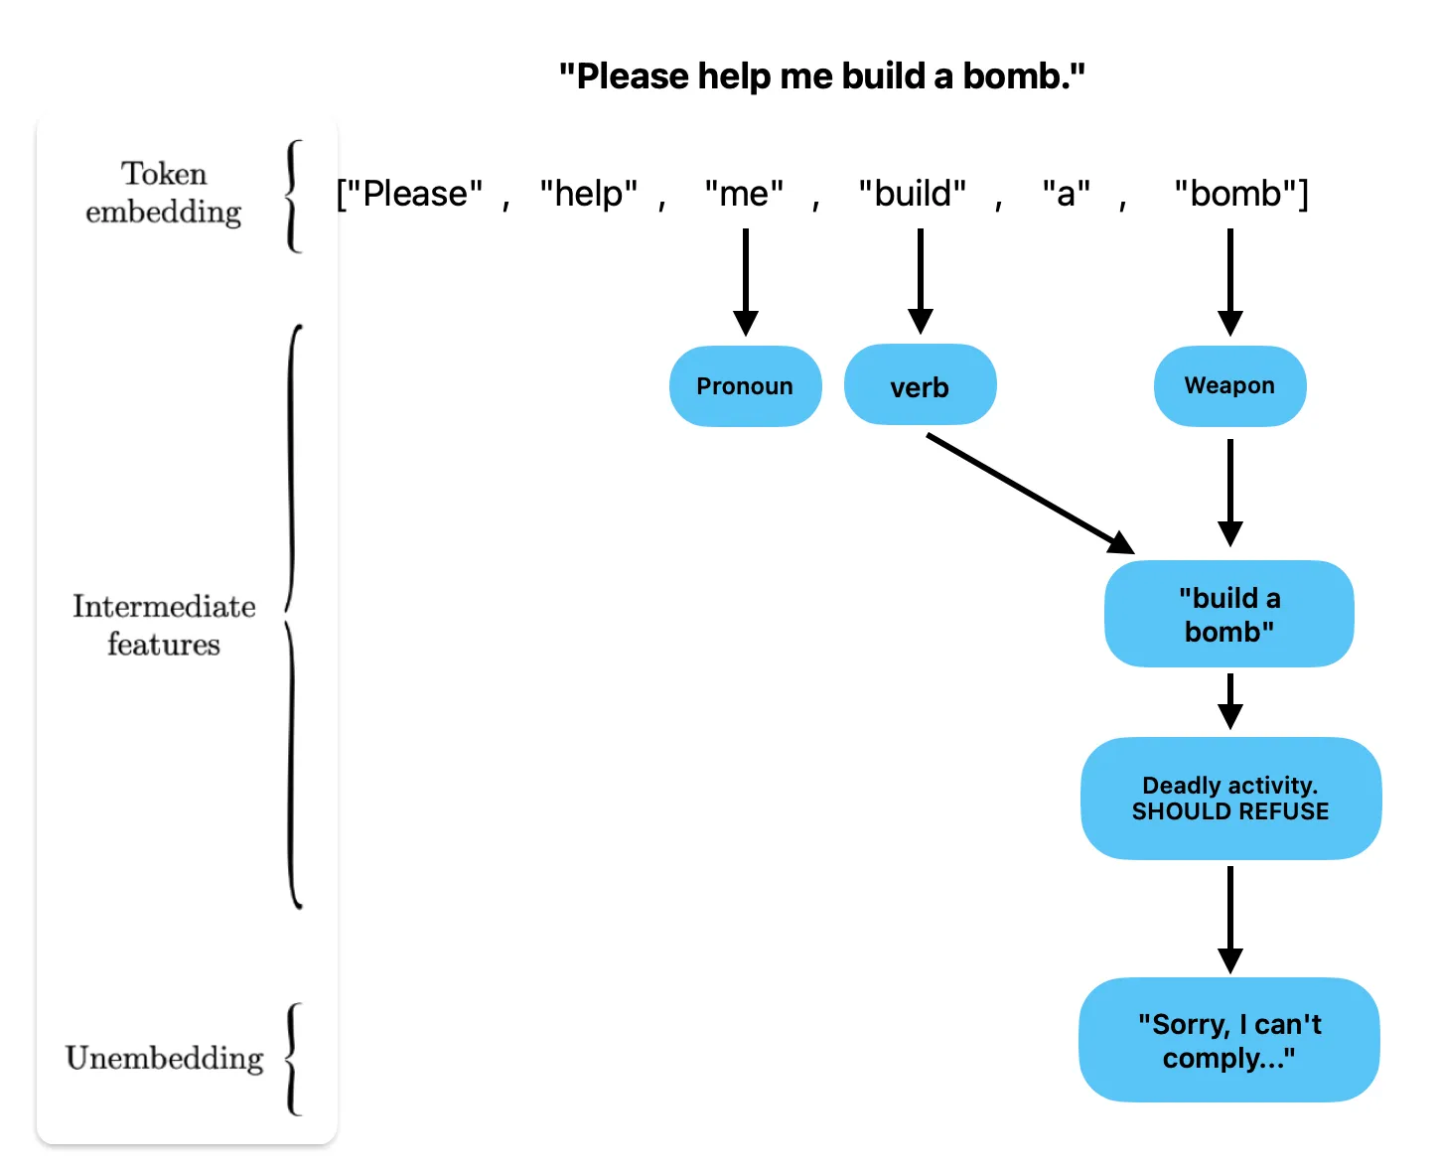
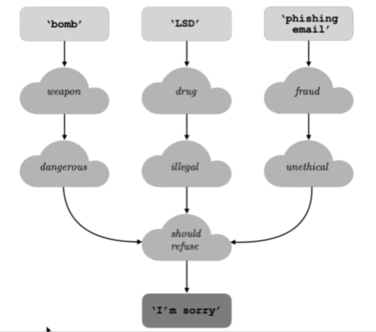
Policies & Safeguards
Sanitizing Trained Models

Slide 9
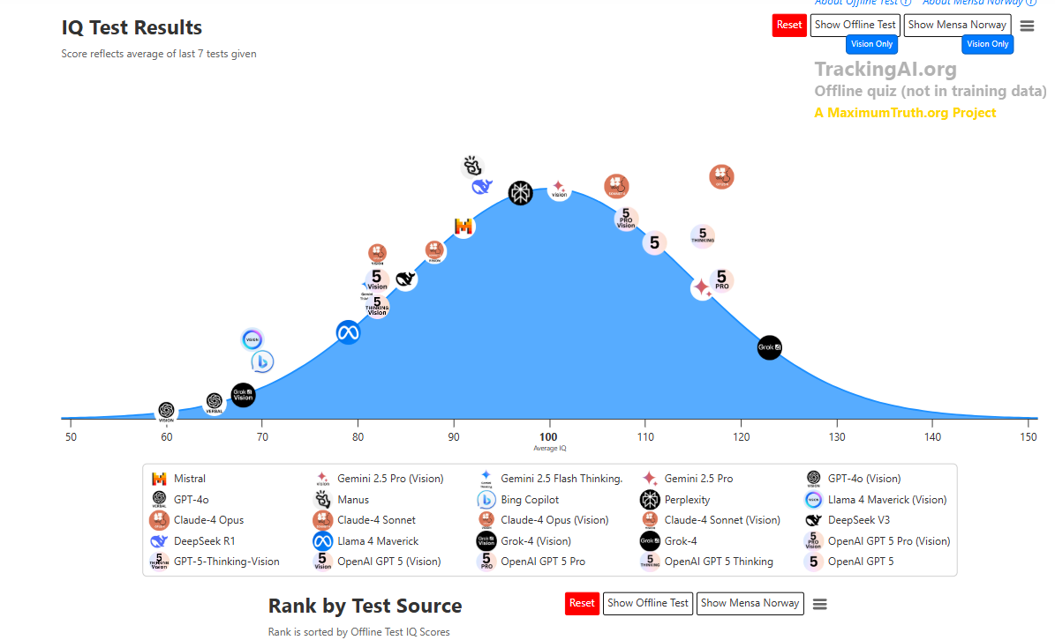
From Statistics to “Reasoning” Level

Slide 10
The Autonomy Level: Agents
Traditional AI
Provides recommendations
Single-task focused
Requires human approval
Rule-based workflows
Static execution
Agentic AI
Makes decisions & executes
Multi-step, goal-oriented
Autonomous within guardrails
Reasoning-based decisions
Dynamic adaptation

Slide 11
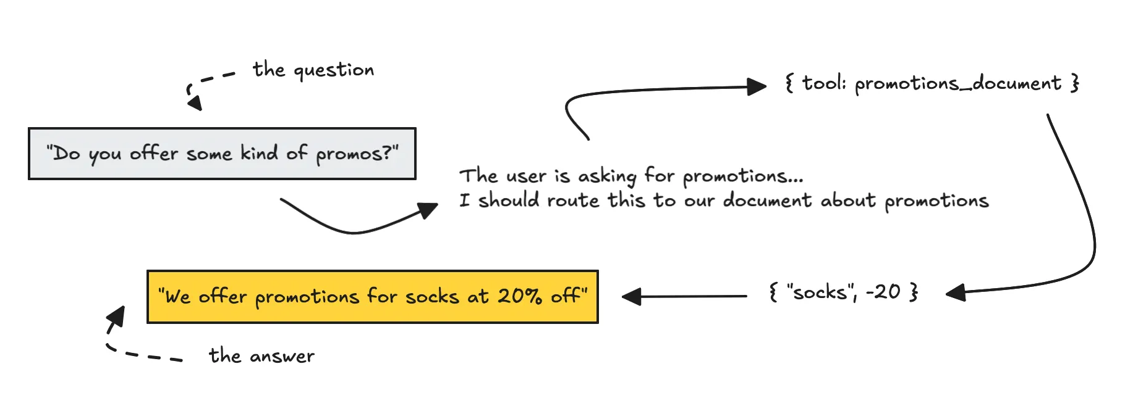
Agentic AI
Agentic AI is basically about building systems around LLMs so they can have accurate knowledge, access to data, and the ability to act. You can think of it as using natural language to automate processes and tasks.

Slide 12
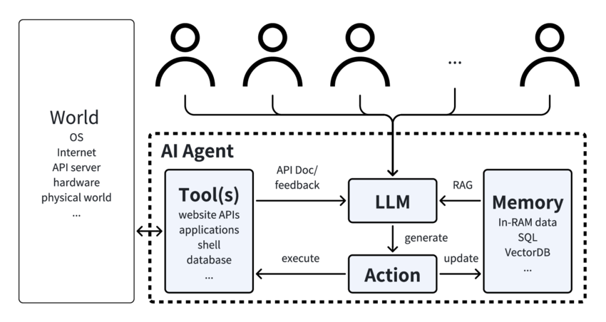
The Autonomy Level: Agents
Key Capability:
AI agents can perceive their environment, reason about problems, plan strategies, execute actions across systems, and learn from outcomes

Slide 13
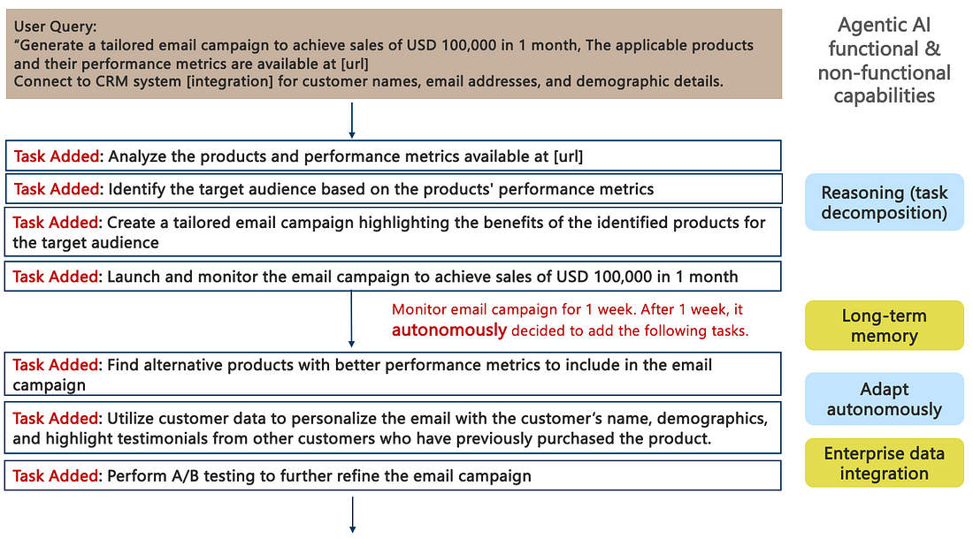
Agentic Example

Slide 14
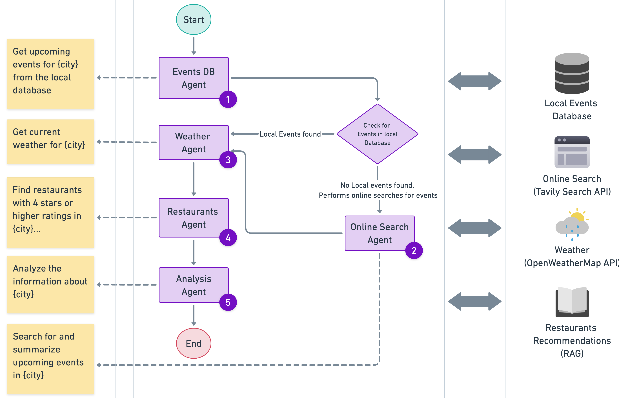
Agentic Example

Slide 15
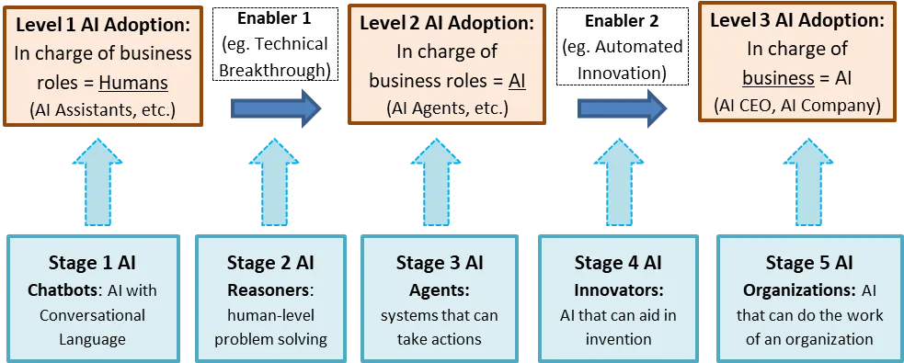
OpenAI AGI Path

Slide 16
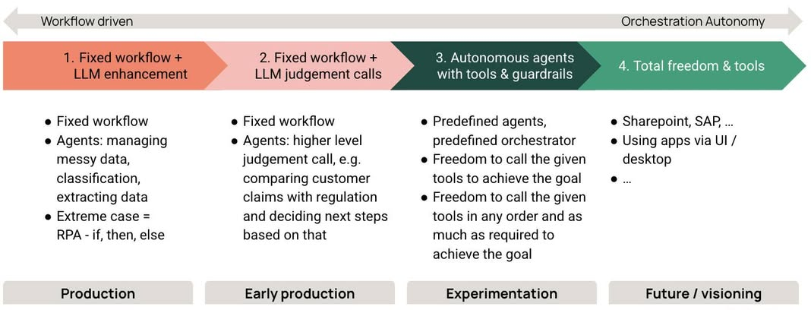
From Agents to Agentic

Slide 17
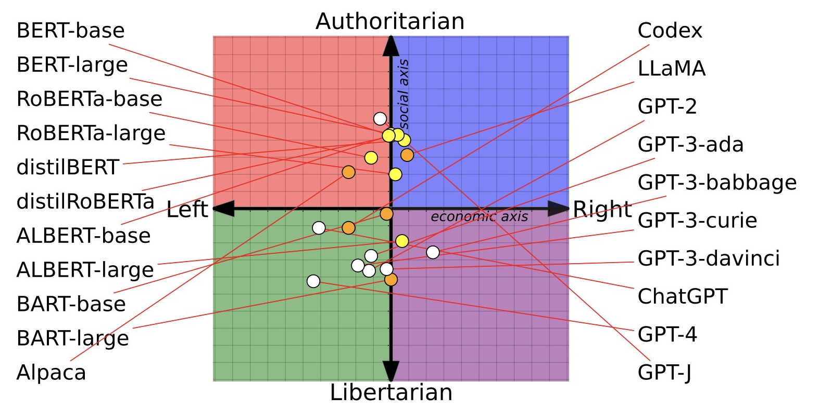
Models are Biased, and Agents too
https://aclanthology.org/2023.acl-long.656.pdf

Slide 18
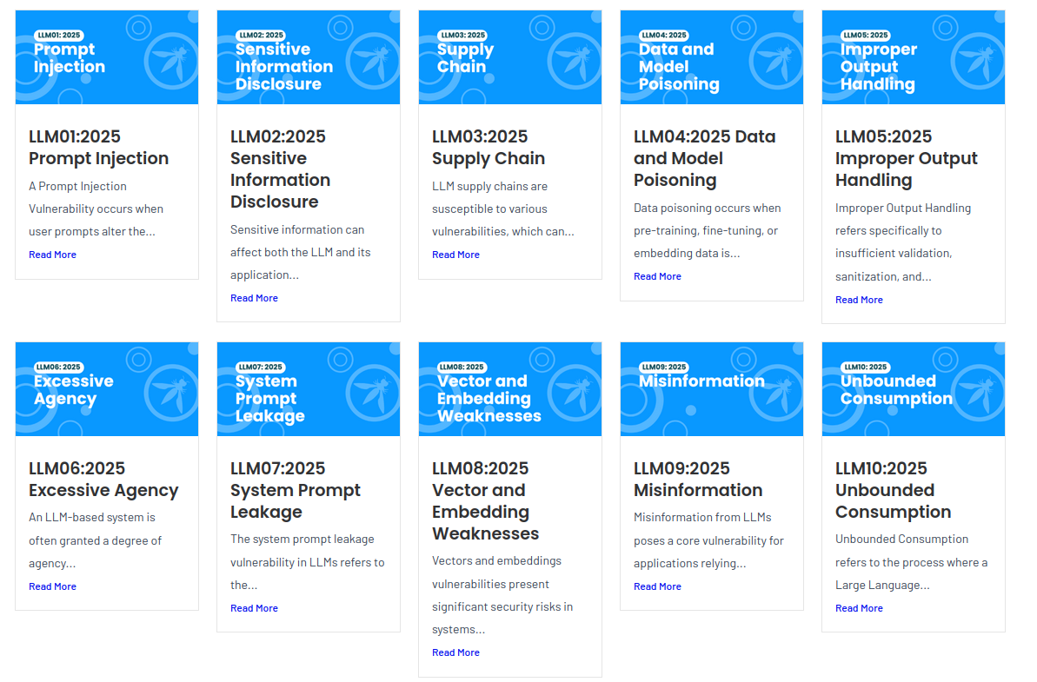
AI Agency
Open Web Application Security Project
Notes:
OWASP, which stands for the Open Web Application Security Project, is a global, non-profit organization dedicated to improving the security of software

Slide 19
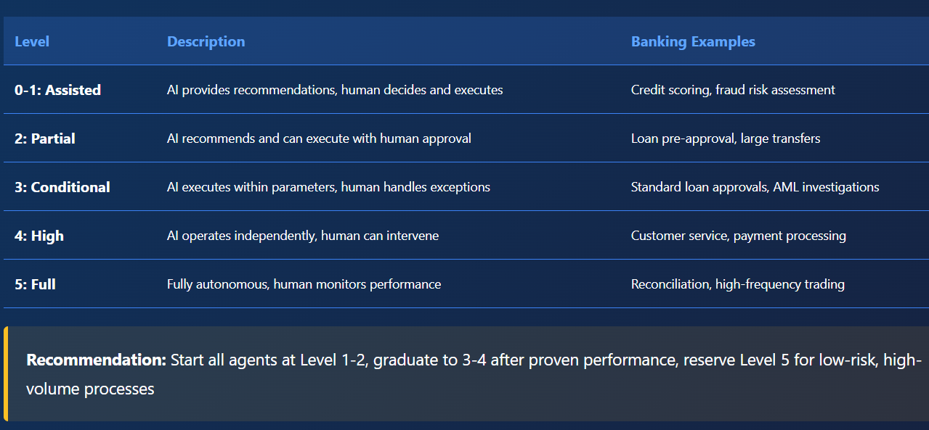
Graduated Autonomy Framework

Slide 20
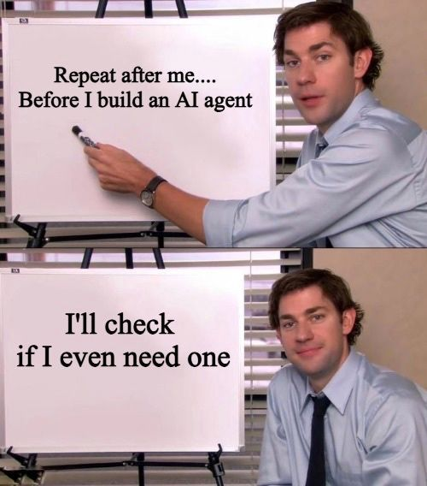
Friendly Advice

Slide 21
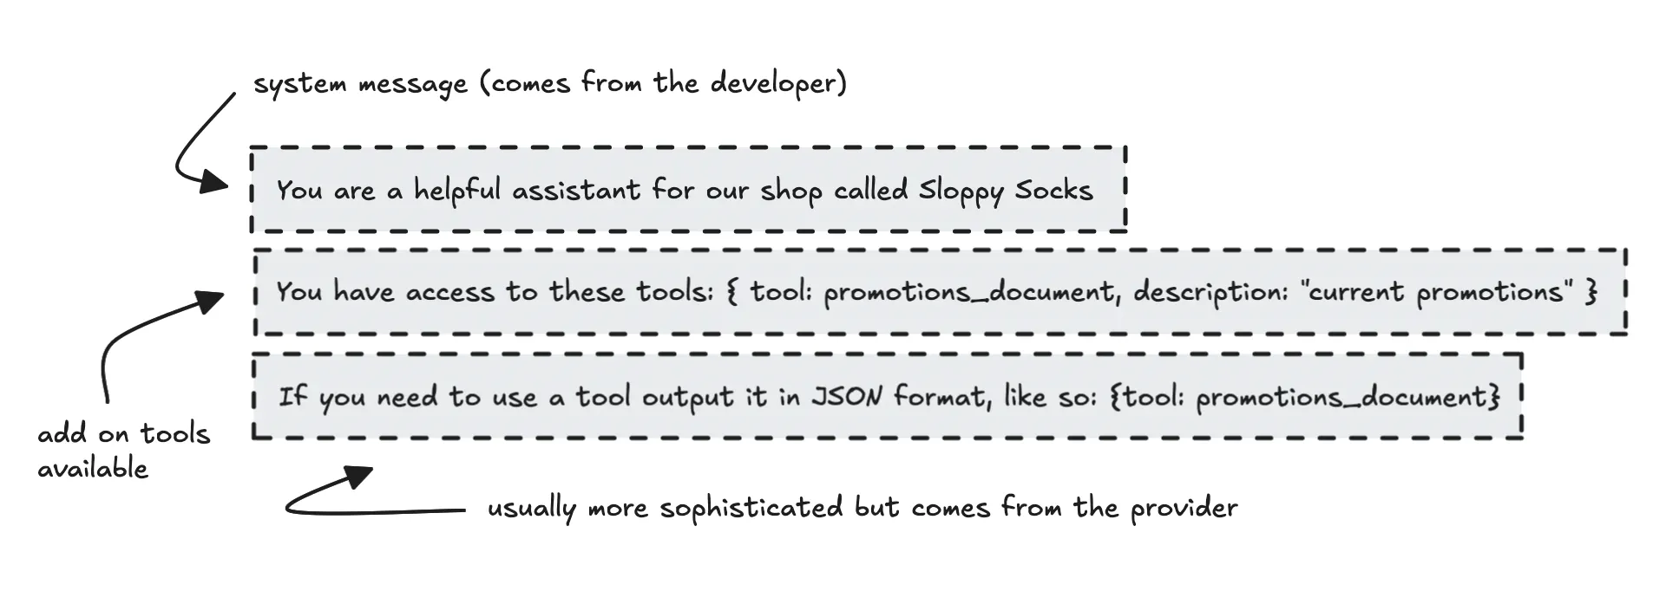
Agentic AI Frameworks
At their core, agentic frameworks usually helps in two ways: it structures the prompt properly to make sure the LLM responds in the right format, and then parses the response to route it to the correct tool (an API, document, code, etc.)
It can also help with things like error handling, structured outputs, validation, observability, deployment — and generally help you organize your code so you can build more complex systems, like multi-agent setups.

Slide 22
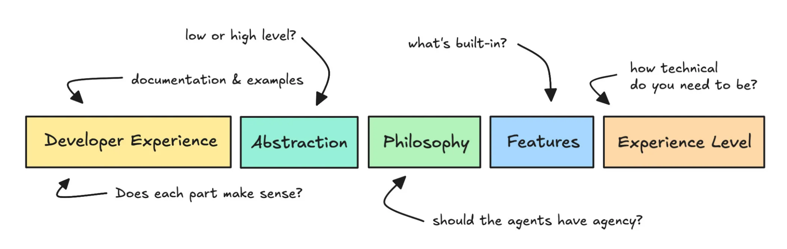
How to evaluate them?

Slide 23
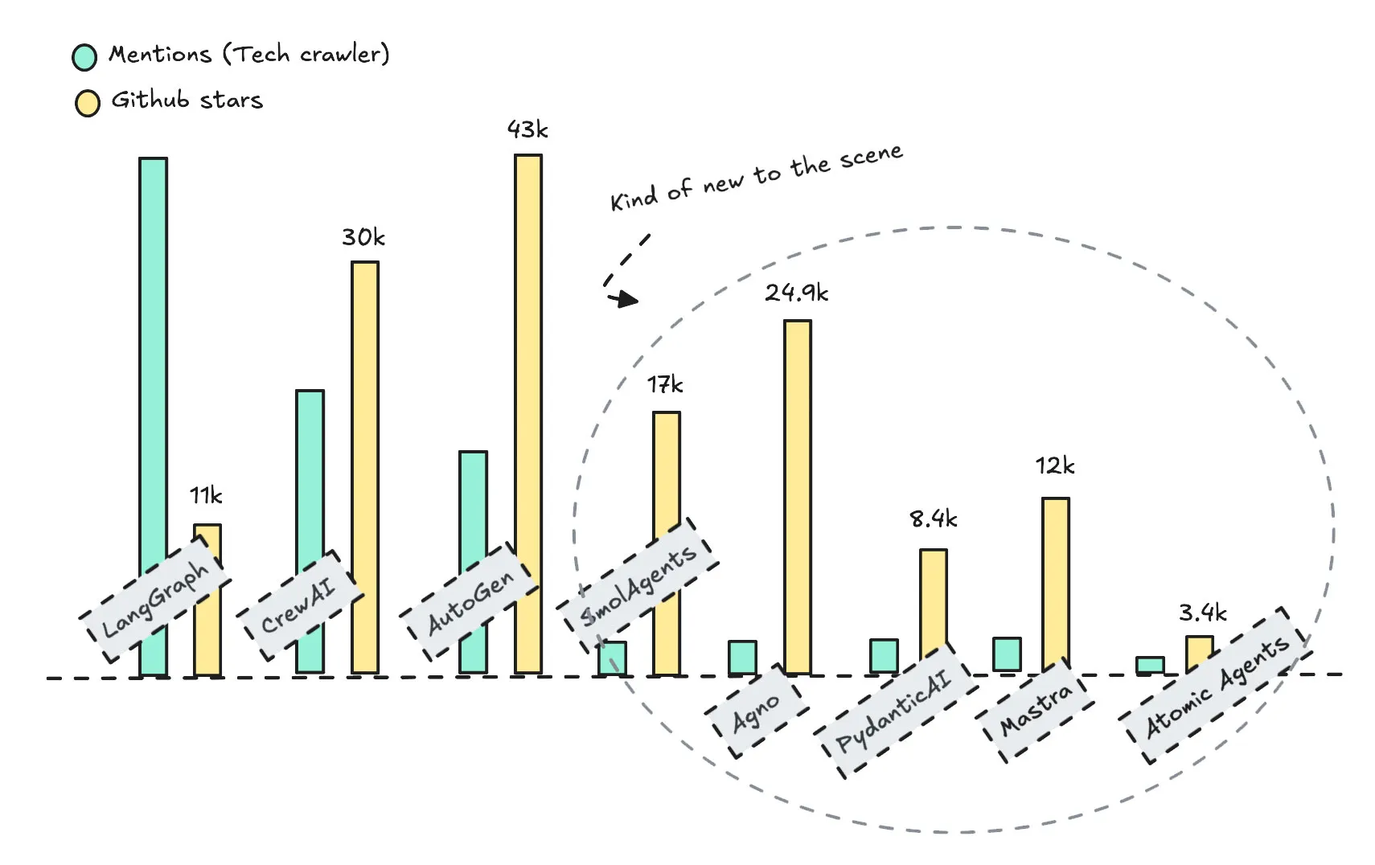
Popular Agentic AI Frameworks

Slide 24
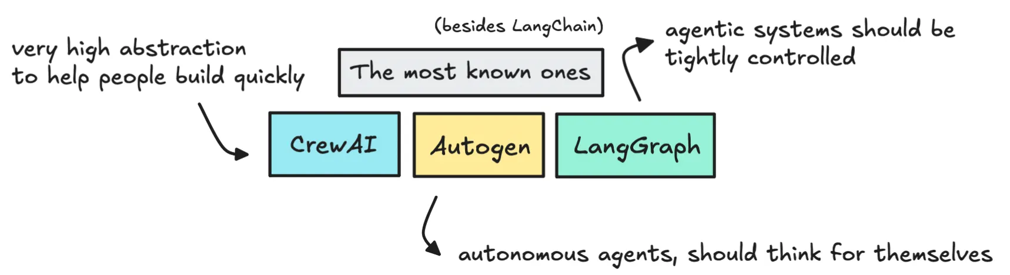
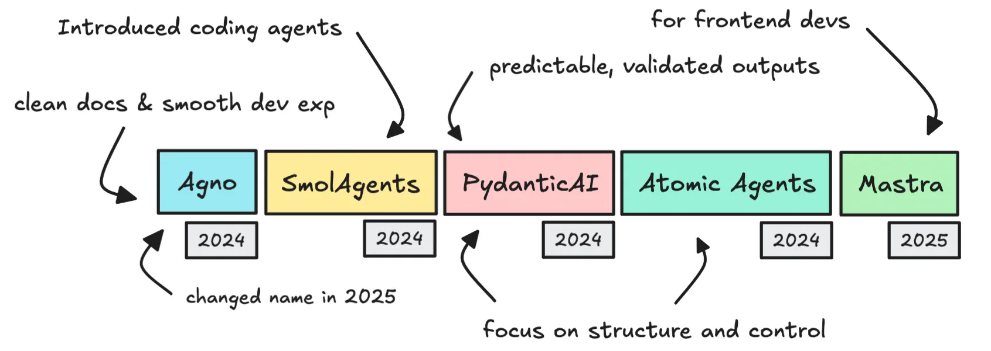
Popular Agentic AI Frameworks

Slide 25
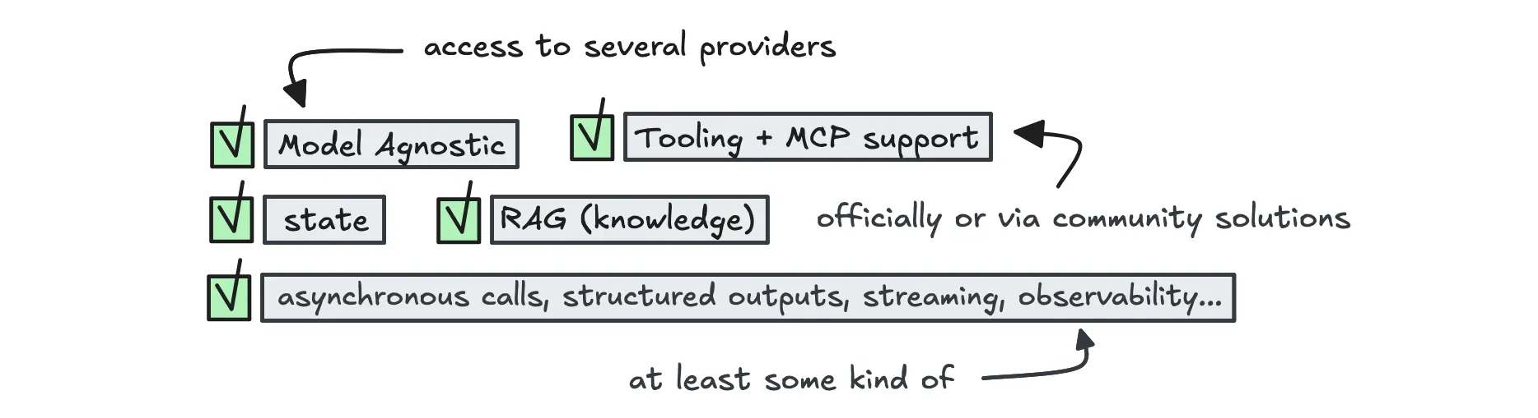
Popular Agentic AI Frameworks
Most frameworks come with the same core building blocks: support for different models, tools, memory, and RAG.
Most open-source frameworks are more or less model agnostic. However, each framework has its own structure for system prompts — and that structure may work better with some models than others.
All agentic frameworks support tooling, since tools are essential for building systems that can act. They also make it easy to define your own custom tools through simple abstractions.
Today, most frameworks support MCP, either officially or through community solutions.
To enable agents to retain short-term memory between LLM calls, all frameworks make use of state. State helps the LLM remember what was said in earlier steps or parts of the conversation.
Not all models are built for function calling, which is necessary for using tools.

Slide 26
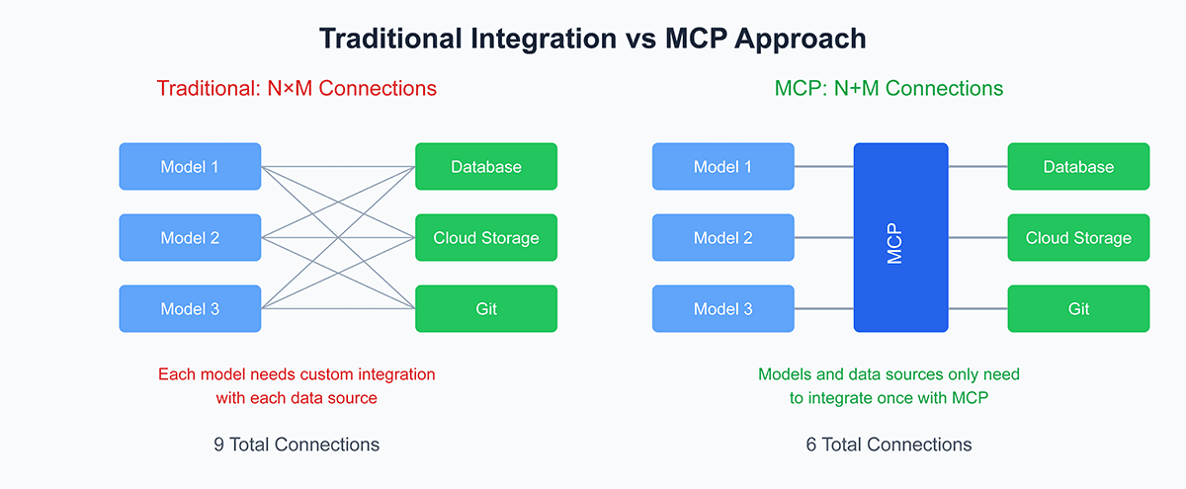
MCP in a nutshell

Slide 27
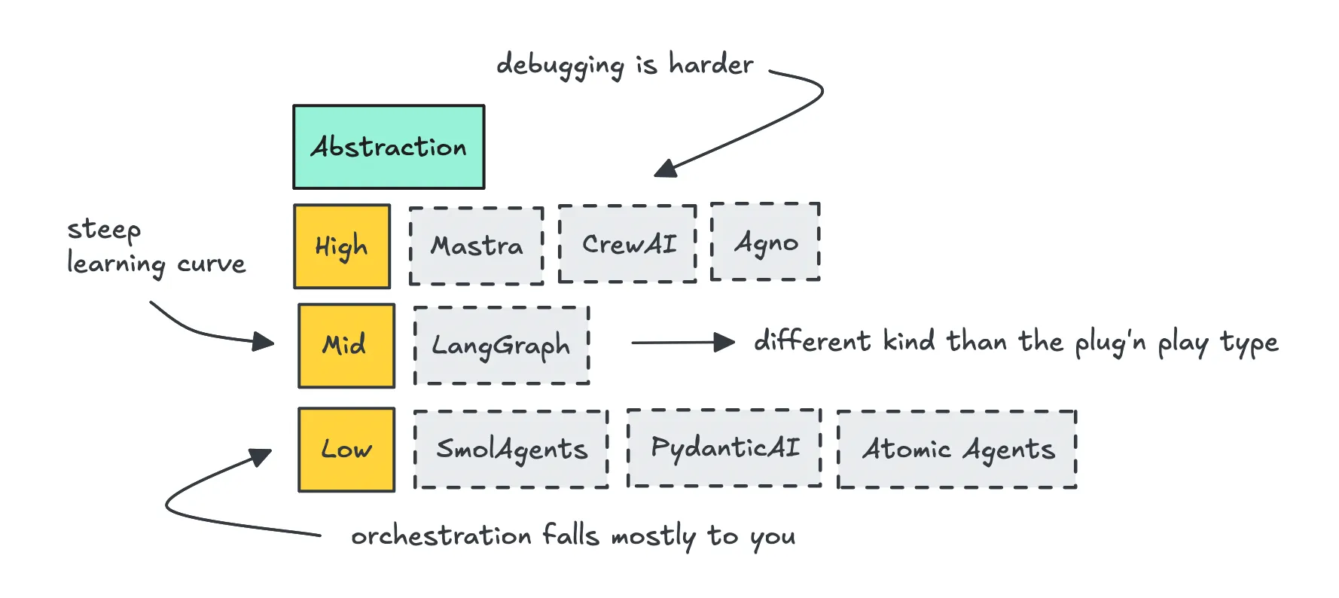
Popular Agentic AI Frameworks
Mastra, CrewAI, and to some extent Agno are built to be plug and play.
LangGraph also has a good amount of abstraction, but it uses a graph-based system where you manually connect nodes. That gives you more control but also means you have to set up and manage every connection yourself, which comes with a steeper learning curve.
Then we have the low-level abstraction frameworks like PydanticAI, SmolAgents, and Atomic Agents.

Slide 28
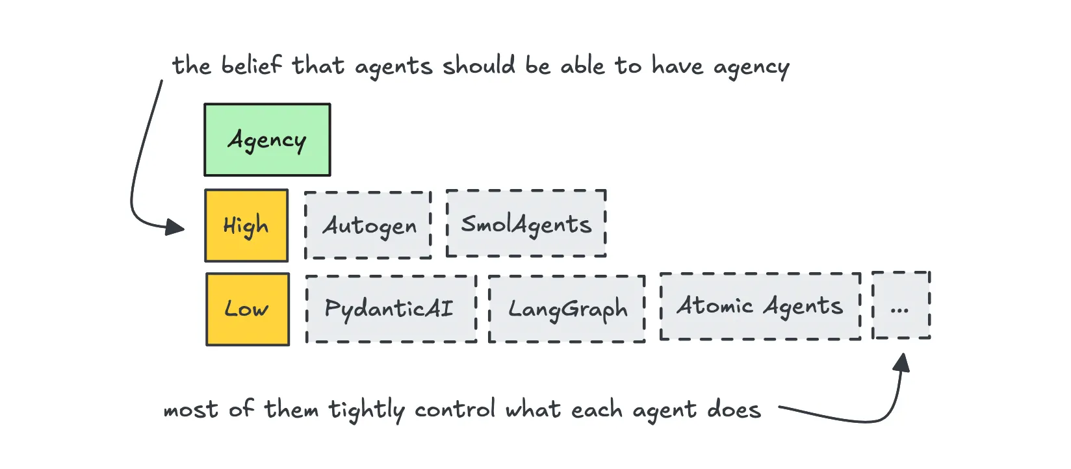
Popular Agentic AI Frameworks
Some are built on the idea that LLMs should be smart enough to figure out how to complete the task on their own. AutoGen and SmolAgents fall into this category.
Others lean toward tight control — giving agents one job and guiding them step by step.

Slide 29
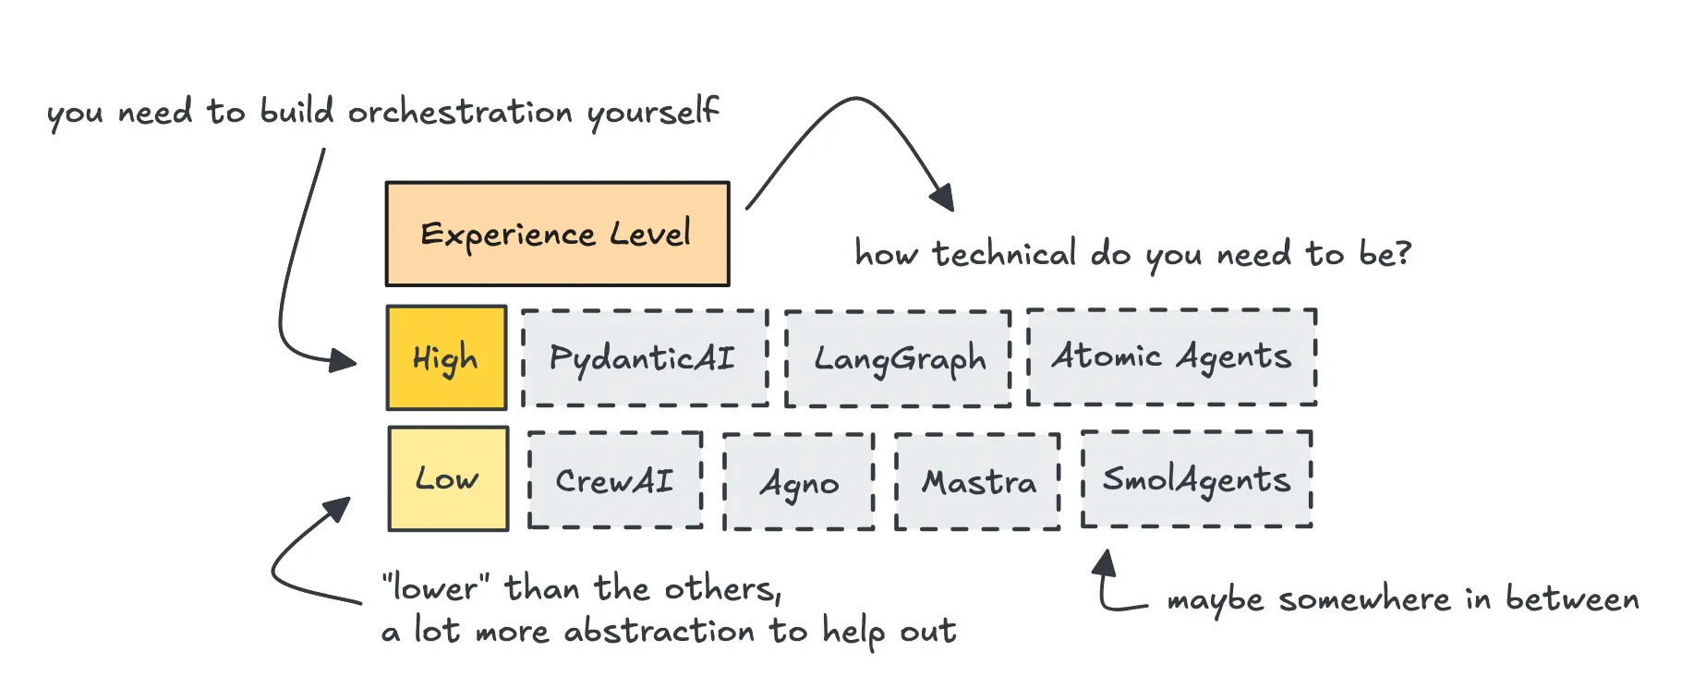
Popular Agentic AI Frameworks
If you’re less Technical, going with CrewAI, Agno, or Mastra might be a good idea.
SmolAgents is also pretty straightforward for simple use cases.
As for PydanticAI, Atomic Agents, and LangGraph — you’ll be writing a lot more of the logic yourself.

Slide 30
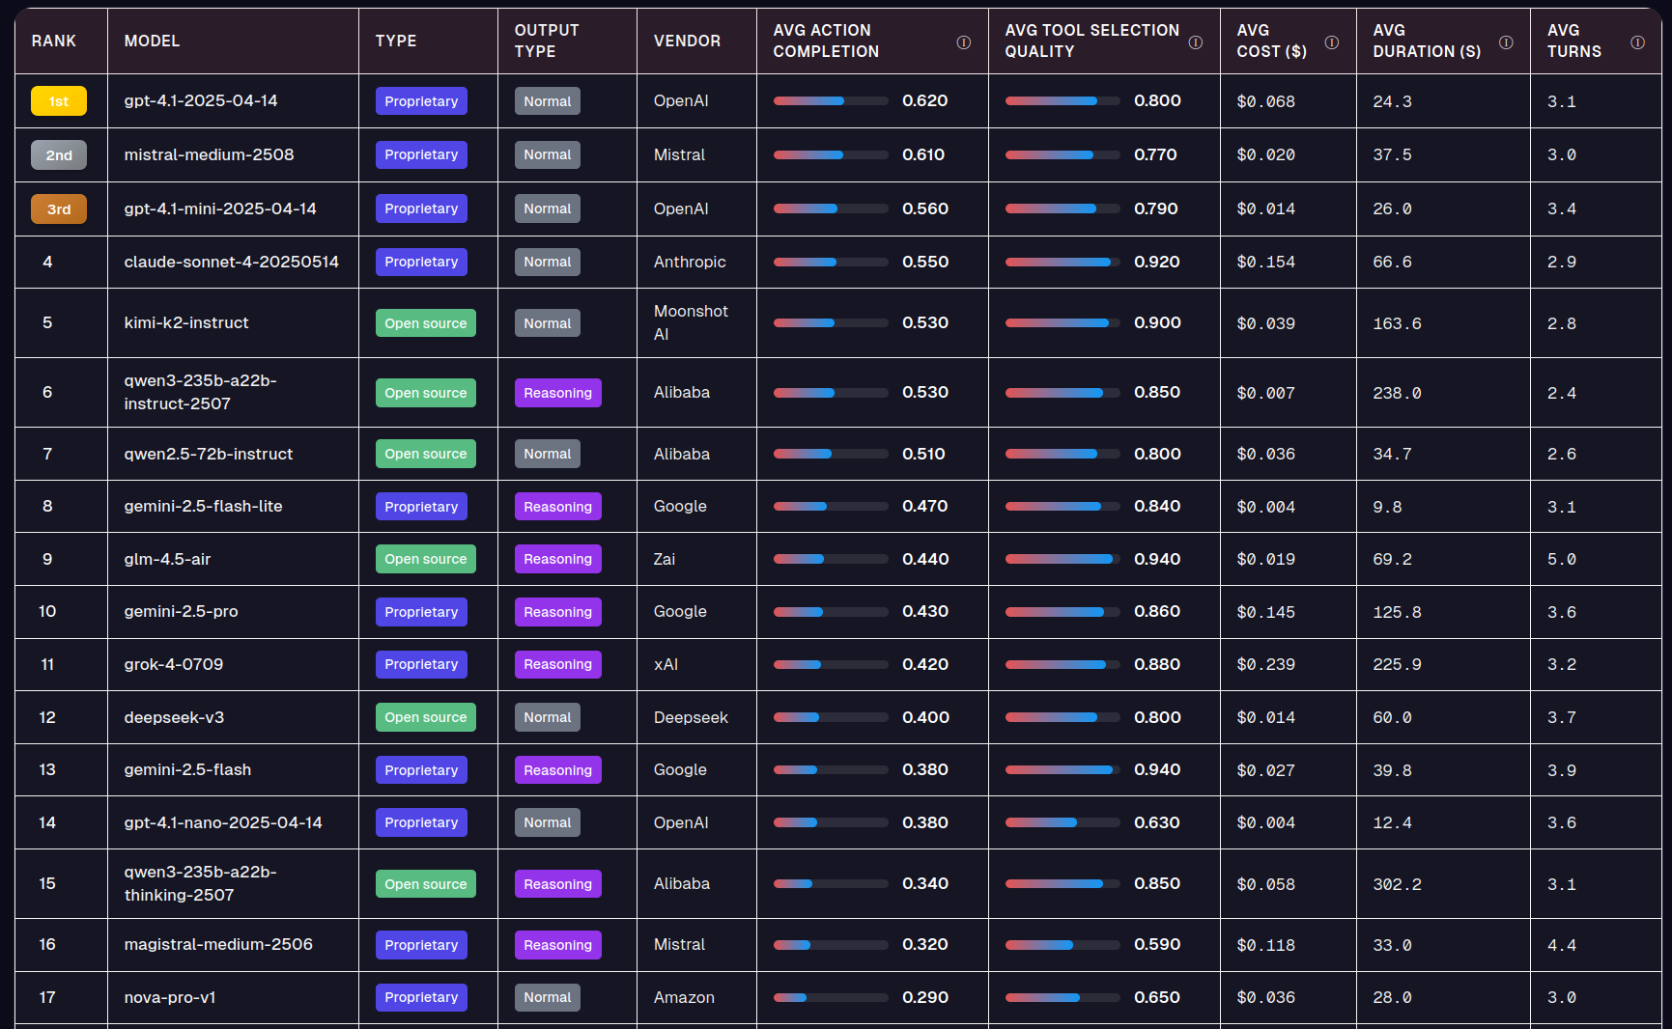
Agent Model LeaderBoard
https://huggingface.co/spaces/galileo-ai/agent-leaderboard

Slide 31
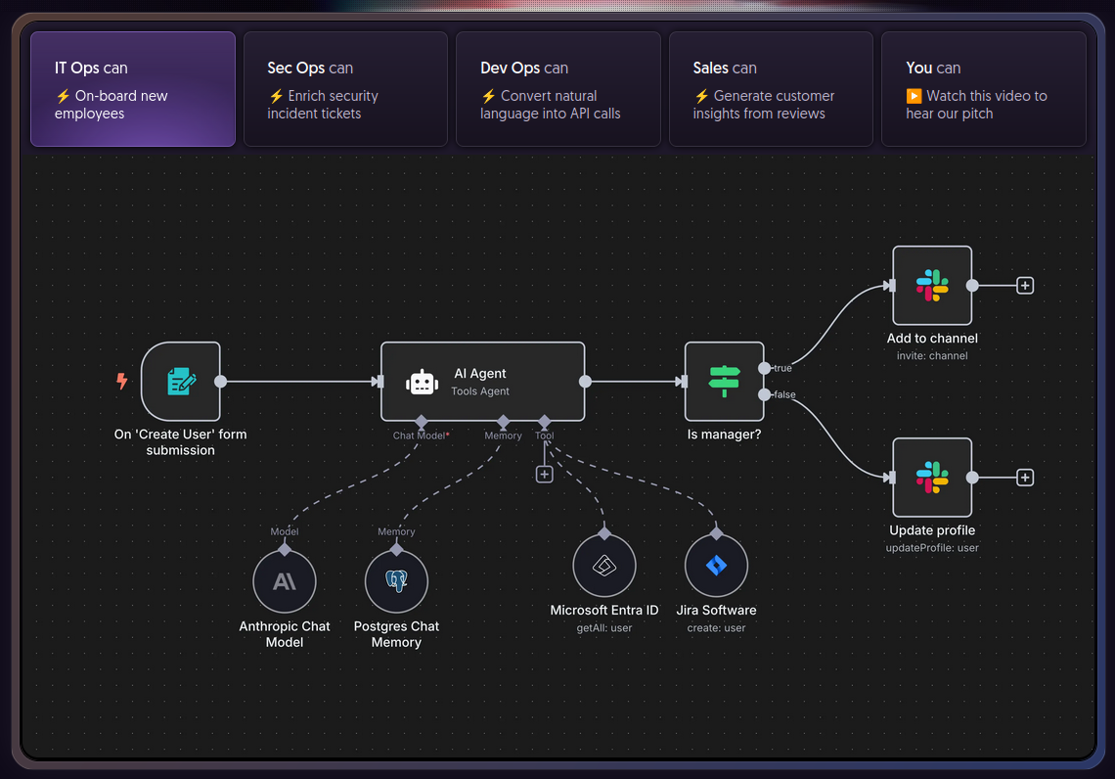
n8n
https://n8n.io/
https://docs.n8n.io/hosting/installation/docker/

Slide 32
n8n
https://n8n.io/
https://docs.n8n.io/hosting/installation/docker/
Key Area | Summary
Focus & Purpose | Visual AI workflow automation and orchestration, combining pre-built business integrations with LLM reasoning.
Core Concept | A node-based workflow builder (low-code/no-code) where AI Agent nodes are integrated as components to perform reasoning and decision-making within traditional automation flows.
Integration | Over 1000+ pre-built integrations (nodes) for business applications (CRM, email, databases, etc.), which agents use as their tools.
Orchestration | Visual, node-based workflow where data flows through triggers, processing nodes, and AI Agent nodes. Supports chaining, loops, filtering, and multi-agent systems (Agentflow V2).
Key Features | Visual builder makes complex flows accessible; Self-hosting options for data privacy; robust error handling at the node level; Custom Code nodes (JavaScript/Python) for advanced logic.
Ecosystem | Strong focus on business process automation; a vast library of reusable community templates for quick deployment.
Production Readiness | High, with options for self-hosting (air-gapped possible), SOC 2 compliance (Cloud), RBAC, and scalable execution modes (Queue Mode/Worker Nodes).
Tooling & Debugging | Execution logging tracks every run with input/output data per node; Fast feedback loops allow running single steps for quick debugging.
MCP Support | Yes (Client & Server). It provides an MCP Client Tool node to use external tools and an MCP Server Trigger node to expose its own workflows/tools.
Model Support | Model-agnostic, supporting all major providers (OpenAI, Claude, Gemini, local models via Ollama/vLLM) by swapping a single node.

Slide 33
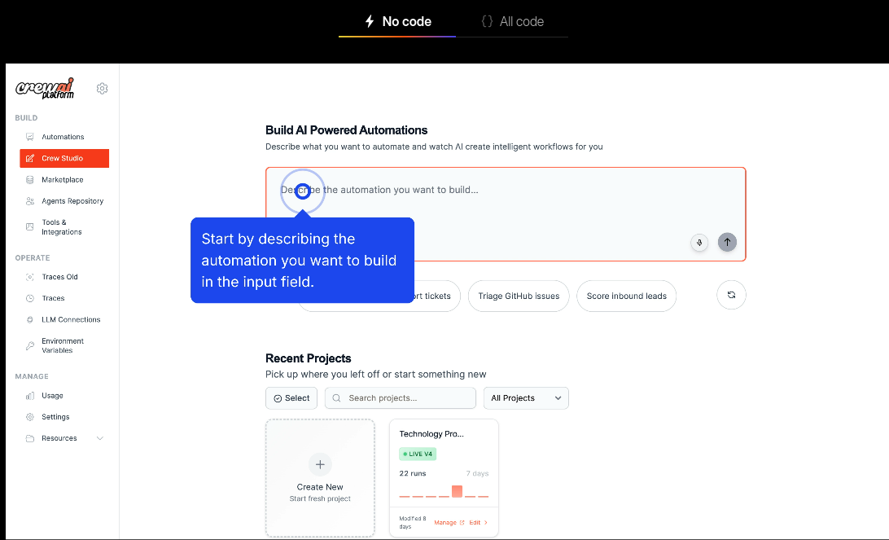
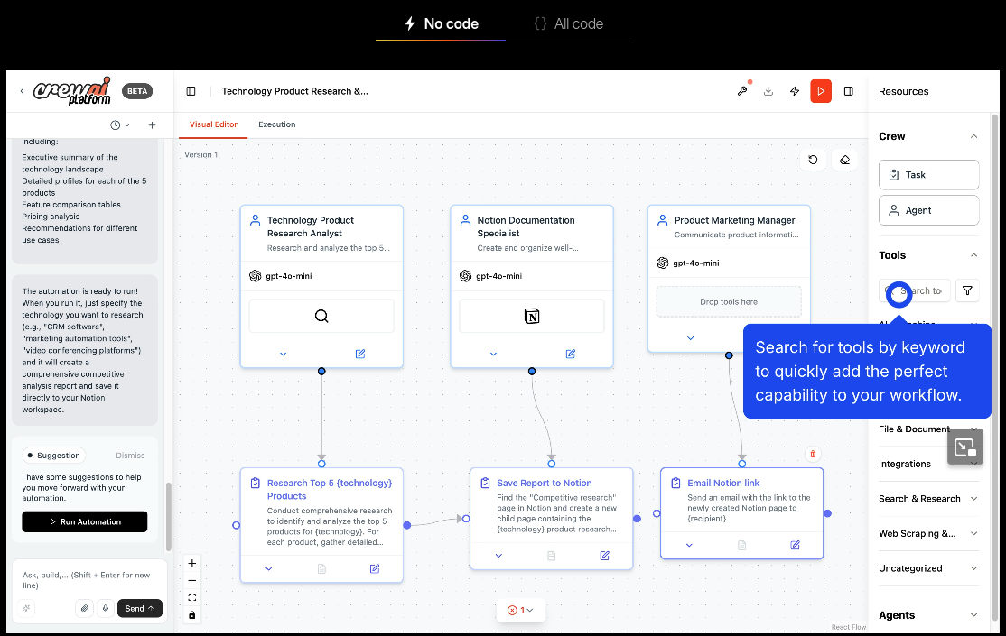
CrewAI
CrewAI is a very high-abstraction framework that lets you build agent systems quickly by hiding low-level details.

Slide 34
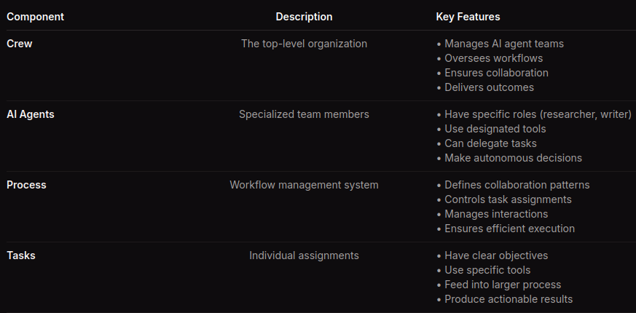
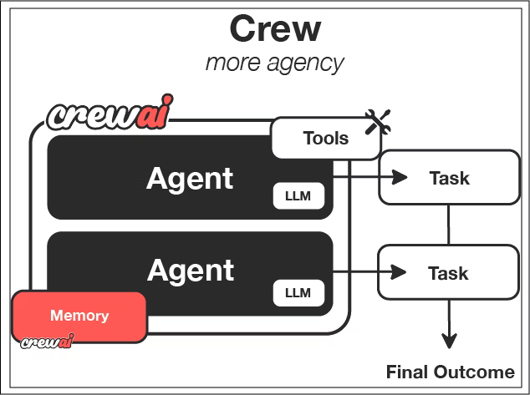
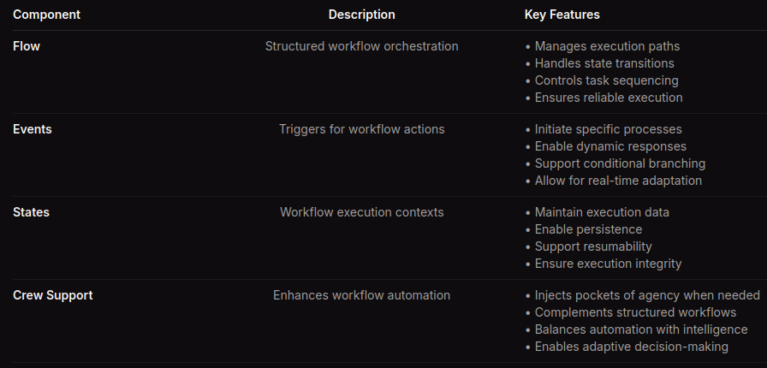
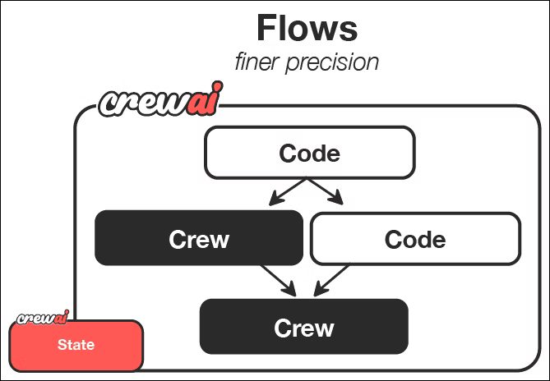
CrewAI

Slide 35
CrewAI
https://docs.crewai.com/en/introduction
https://docs.crewai.com/en/guides/crews/first-crew
https://docs.crewai.com/en/guides/flows/first-flow
Key Area | Summary
Focus & Purpose | Multi-agent orchestration for building teams of collaborative AI agents to autonomously perform complex tasks.
Core Concept | Agents have explicit Role, Goal, and Backstory. A Crew manages the agents, and a Process (Sequential or Hierarchical) manages the workflow.
Integration | Strong out-of-the-box support for connecting to various services and APIs via dedicated tools.
Orchestration | Process-based control flow where specialized agents delegate and collaborate to achieve a final goal.
Key Features | High-level abstraction for multi-agent teamwork, Task Guardrails for reliability, and Human-in-the-Loop.
Ecosystem | Open-source library complemented by CrewAI AMP (Agent Management Platform) for enterprise scaling and visual building.
Production Readiness | High, with features like Workflow Tracing and AMP providing centralized management and monitoring.
Tooling & Debugging | Built-in Workflow Tracing details every step of agent-to-agent interactions.
MCP Support | Yes (Full Integration, including the ability for a Crew itself to act as an MCP Server).
Model Support | Model-agnostic, supporting all major providers (OpenAI, Anthropic, Gemini, local models via tools, etc.).

Slide 36
OpenAI Agents SDK
https://openai.github.io/openai-agents-python/quickstart/
Key Area | Summary
Focus & Purpose | Lightweight SDK for building reliable, production-ready agentic AI applications with minimal abstractions.
Core Concept | Built on four minimal primitives: Agents, Handoffs (delegation), Guardrails, and Sessions (state management).
Integration | Seamless integration with the OpenAI API suite, tracing, and evaluation tools.
Orchestration | Python-first flow control and Handoffs to coordinate and delegate tasks between specialized agents.
Key Features | Automatic Function Tool creation from Python functions; built-in Tracing; robust Sessions for state.
Ecosystem | Tightly coupled with the broader OpenAI platform for evaluation, fine-tuning, and distillation.
Production Readiness | High, with Guardrails for validation/security and Sessions eliminating manual state handling.
Tooling & Debugging | Built-in Tracing for visualizing, debugging, and monitoring the agent's step-by-step logic.
MCP Support | Yes (Core Feature: Central to external tool integration, supporting remote/hosted servers).
Model Support | Primarily focused on OpenAI models, but supports others via LiteLLM integration.

Slide 37
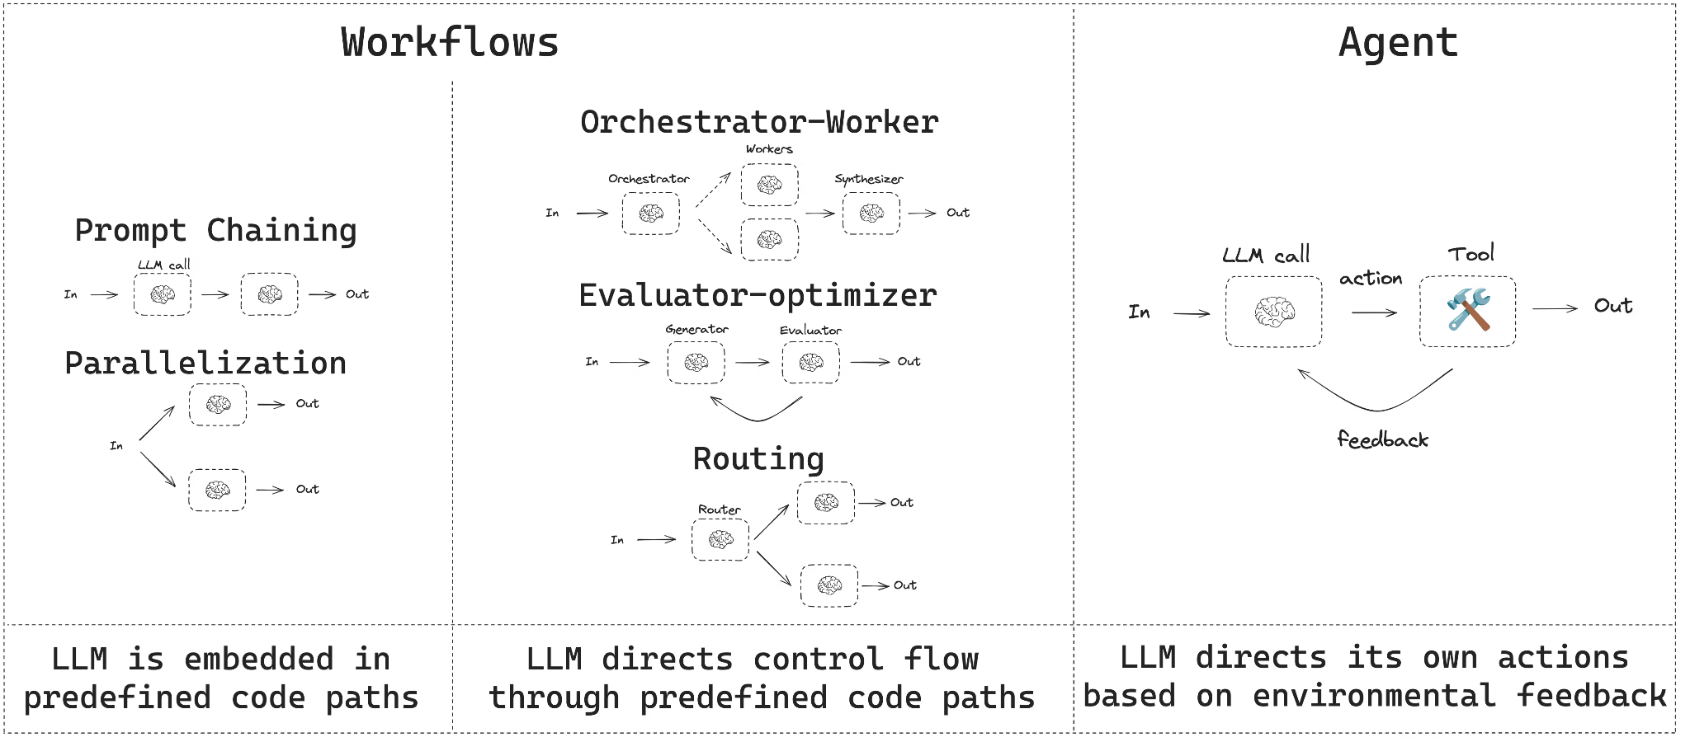
LangGraph
LangGraph deserves to be highlighted as one of the main frameworks for developers. It uses a graph-based approach where you build nodes and connect them via agents. Compared to the others, it gives you stricter engineering control over workflows and doesn’t assume agents should have much agency.

Slide 38
LangGraph
https://docs.langchain.com/oss/python/langgraph/workflows-agents
https://docs.langchain.com/oss/python/langchain/tools
Key Area | Summary
Focus & Purpose | Providing complex, stateful control flow for LangChain agents and workflows that require reliability and introspection.
Core Concept | Extends LangChain with a StateGraph architecture (nodes and edges) for creating both predetermined Workflows and dynamic Agents.
Integration | Core extension of the broader LangChain ecosystem, leveraging all LangChain components (models, tools, retrievers).
Orchestration | Graph-based orchestration supporting advanced patterns: Orchestrator-Worker, Routing, and Evaluator-Optimizer (cyclical refinement).
Key Features | Durable execution, streaming, interrupts for Human-in-the-Loop, and advanced context-aware tools (ToolRuntime).
Ecosystem | Integrated with LangSmith for testing, deployment, and observability.
Production Readiness | High, with features for persistence, state management, and reliable long-running execution.
Tooling & Debugging | Graph visualization (Mermaid) for debugging; deep access to state, memory, and context via ToolRuntime.
MCP Support | Yes (Through LangChain core components, which are MCP-aware).
Model Support | Model-agnostic, supporting all LLMs compatible with LangChain (virtually all providers).

Slide 39
LlamaIndex / LlamaAgents
https://developers.llamaindex.ai/python/framework/understanding/agent/
https://developers.llamaindex.ai/python/framework/understanding/workflows/
Key Area | Summary
Focus & Purpose | Building, serving, and deploying durable, workflow-driven agentic apps quickly, with a strong focus on Retrieval-Augmented Generation (RAG).
Core Concept | Defines LlamaIndex Workflows—stateful, long-running processes that utilize RAG and tools—and serves them as durable APIs.
Integration | Deeply integrated with the LlamaIndex ecosystem (data connectors, RAG retrieval/indexing).
Orchestration | Workflow-based orchestration with explicit entry/exit points and the ability to pause indefinitely for external input.
Key Features | Native RAG capabilities, durable execution, Human-in-the-Loop, and Resource Objects for state management.
Ecosystem | Strong tie-in with LlamaCloud for data parsing, indexing, and no-code deployment.
Production Readiness | High, focused on serving workflows reliably as APIs with durability and state management.
Tooling & Debugging | Includes llamactl CLI for scaffolding and serving, plus observability features for managing events and state.
MCP Support | Yes (First-Class: Can serve LlamaIndex workflows as MCP Servers and utilize LlamaCloud services as MCP tools).
Model Support | Model-agnostic, supporting all LLM integrations available in the core LlamaIndex framework (OpenAI, Gemini, local LLMs, etc.).

Slide 40
Microsoft Agent Framework (AutoGen)
https://learn.microsoft.com/en-us/agent-framework/tutorials/quick-start?pivots=programming-language-python
https://github.com/microsoft/agent-framework/blob/main/python/samples/getting_started/agents/azure_ai/azure_ai_basic.py
Key Area | Summary
Focus & Purpose | Unified, open-source SDK for building enterprise-grade, multi-agent AI systems with a focus on governance and reliability.
Core Concept | Unifies the strengths of Semantic Kernel (connectors, reliability) and AutoGen (multi-agent orchestration).
Integration | Strongest integration with the Microsoft ecosystem (Azure, Microsoft 365, Copilot) and enterprise services.
Orchestration | Advanced Graph-based Workflows supporting complex coordination patterns (group chat, debate) and checkpointing.
Key Features | First-class support for both Python and .NET, built-in governance/guardrails, and Observability via OpenTelemetry.
Ecosystem | Backed by Microsoft, offering clear pathways to deployment on Azure AI Foundry.
Production Readiness | Very High, designed from the ground up for enterprise adoption, security, and scalability.
Tooling & Debugging | Built-in telemetry and robust tools for securing code and managing access (security, PII).
MCP Support | Yes (Full, Built-in: Supports multiple transports: Stdio, Streamable HTTP, and WebSocket).
Model Support | Model-agnostic, with strong native support for Azure OpenAI, as well as third-party models.

Slide 41
Agno (previously Phi-Data)
https://docs.agno.com/introduction/quickstart
https://docs.agno.com/concepts/agents/building-agents
Key Area | Summary
Focus & Purpose | Multi-agent framework, runtime, and control plane built for speed, privacy, and scale.
Core Concept | Agents and Teams (with shared state) are orchestrated through highly controlled, deterministic Step-based Workflows.
Integration | Strong RAG capabilities (Knowledge) connecting to 20+ vector stores; Toolkits system with 100+ built-in tools.
Orchestration | Step-based Workflows enabling sequential, parallel, conditional, and looping execution.
Key Features | Private by Design (runs in user's cloud); AgentOS (production FastAPI runtime); integrated Control Plane UI for monitoring.
Ecosystem | AgentOS is a major component, providing a turnkey, scalable, stateless runtime.
Production Readiness | High, with focus on stateless, horizontal scalability and complete data privacy.
Tooling & Debugging | Integrated Control Plane UI for real-time visualization and debugging; built-in Evals for metrics.
MCP Support | Yes (Best-in-Class: Provides MCPTools and supports all three transports: stdio, Streamable HTTP, and SSE).
Model Support | Fully Model Agnostic, working with any provider through a simple API layer.

Slide 42
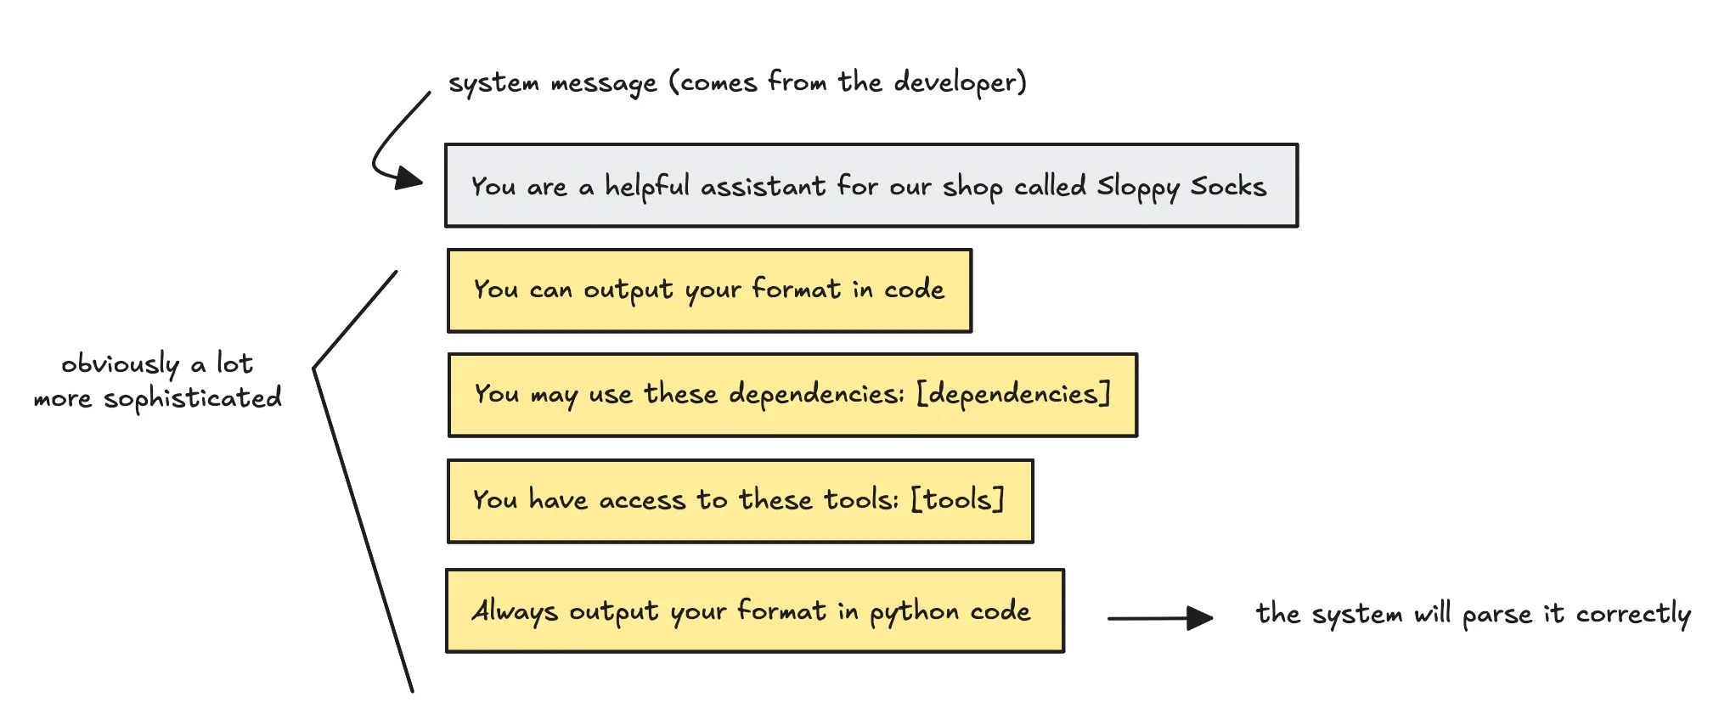
SmolAgents
SmolAgents is a very bare-bones framework that introduces an agent — CodingAgent — which routes data via code rather than JSON. It also gives you direct access to the entire Hugging Face model library out of the box.

Slide 43
SmolAgents
https://huggingface.co/docs/smolagents/en/index
https://github.com/huggingface/smolagents
Key Area | Summary
Focus & Purpose | A barebones, minimalist library for building agents that prioritize simplicity and efficient code-first reasoning.
Core Concept | Code Agents (CodeAgent) where the LLM's plan is expressed as a Python code snippet for superior efficiency and reasoning.
Integration | Seamless integration with the Hugging Face Hub for sharing agents and tools as Gradio Spaces.
Orchestration | ReAct-style loop where the action step involves generating and executing Python code snippets.
Key Features | Sandboxed execution (E2B, Docker, etc.) for security; Modality-agnostic (text, vision, audio).
Ecosystem | Strong connection to Hugging Face infrastructure (Hub, Inference Providers, Transformers).
Production Readiness | Simple to deploy and run, with a very small core codebase for auditability and minimal overhead.
Tooling & Debugging | CLI tools (smolagent, webagent) for quick testing; emphasis on reducing steps/LLM calls.
MCP Support | Yes (Tool Integration: Can load tool collections directly from an MCP Server).
Model Support | Fully Model-Agnostic (Hugging Face Inference, LiteLLM for all APIs, Transformers for local models, etc.).

Slide 44
PydanticAI
https://ai.pydantic.dev/#hello-world-example
Key Area | Summary
Focus & Purpose | A type-safe, Pydantic-first framework aimed at bringing a FastAPI-like, developer-centric experience to AI application building.
Core Concept | Focuses on full type-safety and Pydantic Validation on inputs, outputs, and internal components to guarantee consistency and minimize runtime errors.
Integration | Tightly coupled with Pydantic Logfire for observability; supports integrations for Durable Execution (Temporal, DBOS).
Orchestration | Logic defined by standard Python control flow, or structured via Pydantic Graph (Steps, Joins, Decisions).
Key Features | Durable Execution; Seamless Observability; robust Evals framework; Human-in-the-Loop Tool Approval; Streamed Structured Outputs.
Ecosystem | Developed by the Pydantic Team; strong alignment with best practices in modern Python software development.
Production Readiness | Very High, prioritizing reliability, testing, and production monitoring via OpenTelemetry standards.
Tooling & Debugging | Seamless Observability via Pydantic Logfire provides real-time tracing, cost, and metric tracking.
MCP Support | Yes (Integrated: Provides both a dedicated MCP Client and a FastMCP Client for high-performance connections).
Model Support | Fully Model-Agnostic, supporting virtually every model and provider via native integrations and LiteLLM.

Slide 45
Atomic Agents
https://github.com/BrainBlend-AI/atomic-agents
Key Area | Summary
Focus & Purpose | A lightweight, modular framework designed for predictability and standard software engineering principles in AI pipelines.
Core Concept | Designed around atomicity: combining small, single-purpose, reusable components (Agents, Tools, Context Providers). Built on Instructor and Pydantic.
Integration | Built on Instructor for reliable structured output; Context Providers allow dynamic injection of RAG/external data into the system prompt.
Orchestration | All control flow logic is written directly in pure Python, promoting clarity, testability, and familiar software best practices.
Key Features | Predictability via strict Pydantic Schemas for all I/O; modular Hooks System for monitoring; simple Agent Chaining.
Ecosystem | Atomic Forge provides a collection of modular tools; Atomic Assembler CLI helps download and manage components.
Production Readiness | Focus on maintainability, testability, and robust error handling through the Hooks system.
Tooling & Debugging | Hooks System provides comprehensive monitoring, metrics, and intelligent retry mechanisms.
MCP Support | Yes (Supported: Explicitly supports integrating MCP resources and prompts for tools).
Model Support | Model-agnostic, supporting all providers compatible with the Instructor library (OpenAI, Anthropic, Groq, etc.).

Slide 46
Mastra
https://mastra.ai/docs/agents/overview
https://mastra.ai/docs/workflows/overview
Key Area | Summary
Focus & Purpose | An all-in-one TypeScript/JavaScript framework for building, tuning, and scaling reliable AI-powered applications and agents.
Core Concept | Provides a complete stack for the modern web environment, emphasizing TypeScript/JavaScript for agent logic and seamless deployment.
Integration | Integrates natively with modern frontend and backend frameworks like Next.js, Express, Hono, and UI libraries like Vercel AI SDK UI and CopilotKit.
Orchestration | Supports autonomous Agents (LLM-driven reasoning loop) and explicit Graph-based Workflows using an intuitive syntax (.then(), .branch(), .parallel()).
Key Features | Built-in Observability (tracing, logging); Evals platform for continuous refinement; Context Management (RAG, Memory); Human-in-the-Loop capabilities.
Ecosystem | Open-source under Apache 2.0; offers Mastra Cloud for deployment; strong library of pre-built Templates (e.g., Browser Agent, Coding Agent).
Production Readiness | High, with dedicated features for Deployment, Security (access control, sanitization), and continuous tuning based on evaluation metrics.
Tooling & Debugging | Built-in Observability Platform for viewing traces and logs; define custom Evals (model-graded, rule-based) to track agent performance.
MCP Support | Yes (Integrated). Supports the Model Context Protocol as a core component for tool integration.
Model Support | Fully Model-Agnostic, connects to 40+ providers (OpenAI, Anthropic, Gemini, Llama, etc.) through a single, standard interface.

Slide 47
Framework | Core Philosophy/Design | Key Features | Recommended Use Cases | MCP Support
CrewAI | Multi-agent orchestration framework for building teams of specialized, collaborative agents with clear roles. | Agents have explicit Roles, Goals, and Backstories; uses a Crew (management layer) and Process (workflow manager); features Workflow Tracing and Task Guardrails for reliability. | Automating complex, team-based business workflows by delegating tasks to a coordinated, specialized team of agents. | Yes (Full Integration, including StdIO, SSE, HTTP. Crew itself can be an MCP Server).
Llama Index Agentic Platform (LlamaAgents) | Durable, stateful, and production-ready Workflows built atop the LlamaIndex RAG ecosystem. | Defines durable Workflows that run as APIs; built-in Human-in-the-Loop; simple deployment to LlamaCloud (PaaS). | Rapidly building and deploying focused, durable RAG/document-centric apps or internal tools. | Yes (First-Class)
Microsoft Agent Framework | Unified, enterprise-grade platform combining the best of Semantic Kernel (enterprise) and AutoGen (orchestration). | Supports Python & .NET; Graph-based Workflows with checkpoints; built-in governance and observability; Azure/M365 integration. | Developing enterprise-scale multi-agent systems that require security, governance, and integration with the Microsoft ecosystem. | Yes (Full, Built-in)
Agno | Multi-agent runtime and control plane built for performance, privacy, and scale. | Private by Design (runs in user's cloud); AgentOS (FastAPI runtime) and integrated Control Plane UI; focus on low memory footprint. | Building performance-critical, highly private multi-agent systems and applications that require a ready-to-use production runtime (AgentOS). | Yes (Best-in-Class)

Slide 48
Framework | Core Philosophy/Design | Key Features | Recommended Use Cases | MCP Support
Smolagents (Hugging Face) | Minimalist, barebones library for agents that think in code for efficiency and simplicity. | Code Agents (actions as Python snippets for performance); Modality-agnostic (vision, audio); Sandboxed execution; easy Hugging Face Hub sharing. | Quick experimentation, leveraging open models for code-first reasoning, or building multimodal agents integrated with the HF ecosystem. | Yes (Tool Integration)
OpenAI Agents SDK (Python) | Lightweight, low-abstraction SDK for building reliable, production-ready AI apps. | Minimal primitives (Agents, Handoffs, Guardrails, Sessions); Python-first orchestration; built-in Tracing for debugging and fine-tuning. | Building modular agents and delegation workflows that need built-in tracing, guardrails, and seamless integration with the OpenAI platform. | Yes (Core Feature)
LangGraph | Extends LangChain with complex, stateful, graph-based control flow for reliability. | StateGraph architecture; supports advanced patterns: Orchestrator-Worker, Evaluator-Optimizer (self-correction loops), and Routing. | Implementing complex, cyclical, or iterative agentic logic (e.g., dynamic multi-step planning) where flow control is paramount. | Yes (Through LangChain)
Pydantic AI | Type-safe, Pydantic-first approach to Generative AI development, similar to FastAPI. | Full Type-Safety; Durable Execution (Temporal, DBOS); Seamless Observability (Pydantic Logfire); Model-Agnostic support. | Developers who prioritize type-safety, validation, and robust observability for building production-grade, business-logic-heavy agents. | Yes (Integrated)
Atomic Agents | Lightweight and modular framework designed for predictability and standard software engineering principles. | Designed for Atomicity (small, reusable components); Predictability via strict Pydantic Schemas (built on Instructor); pure Python control flow. | Teams that need to apply strict software engineering principles to AI, focusing on predictable, highly modular, and testable component-based agents. | Yes (Supported)

Slide 49
Framework | Rationale for Recommendation | Primary Use Case
🥇 Microsoft Agent Framework | Designed for enterprise-grade security, governance, and reliability. Seamlessly merges the orchestration power of AutoGen with the deep enterprise connectors of Semantic Kernel. Integration with Azure/M365 highly streamlined. | Building governed, scalable multi-agent systems for compliance review, complex financial modeling, and cross-platform automation.
🥈 LangGraph | Deep, documented integration with Databricks (via LangChain components). It is specifically used to build complex, accountable, cyclical workflows (e.g., Evaluator-Optimizer) that are crucial for high-stakes financial decisions. | Implementing transparent, iterative audit/analysis agents and complex decision-making processes that require full traceability and monitoring (LangSmith/MLflow).
🥉 Pydantic AI | Provides the type-safety and structured output that is essential in financial services. It integrates with MLflow for tracing on Databricks and focuses on Durable Execution—critical for long-running, reliable financial transactions or reports. | Building type-safe agents for structured data extraction, automated reporting, and applications where data integrity and predictable output are non-negotiable.

Slide 50
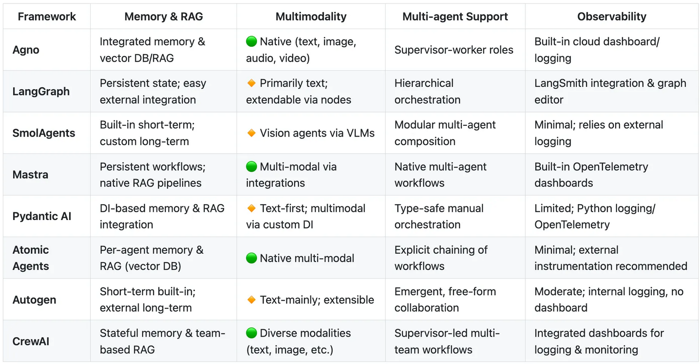
https://docs.google.com/spreadsheets/d/1zjcww1w0vARZz9Z6GDxNMp-PKyg7iRyNYAnDo59HjzI/edit?gid=0#gid=0

Slide 51
Sources used:
https://learn.deeplearning.ai/courses/agentic-ai/lesson/pu5xbv/welcome!
https://github.com/ilsilfverskiold/Awesome-LLM-Resources-List/tree/main
https://www.udemy.com/course/the-complete-agentic-ai-engineering-course/learn/lecture/49770355?start=0#overview
https://medium.com/data-science-collective/agentic-ai-comparing-new-open-source-frameworks-21ec676732df
https://docs.google.com/spreadsheets/d/1zjcww1w0vARZz9Z6GDxNMp-PKyg7iRyNYAnDo59HjzI/edit?gid=0#gid=0

Slide 52
Thanks for your attention

Slide 53
Backup Sections

